Slide 1
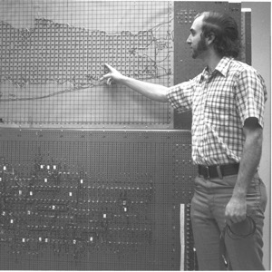
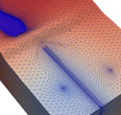
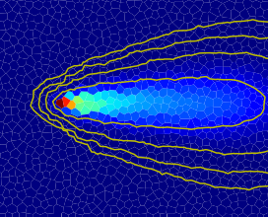
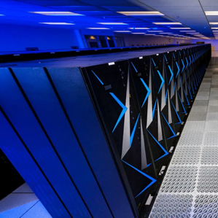


Extended MODFLOW Parallel Computing and NetCDF
Advanced MODFLOW Training Class, November 22, 2024, Deltares, NL

Slide 2
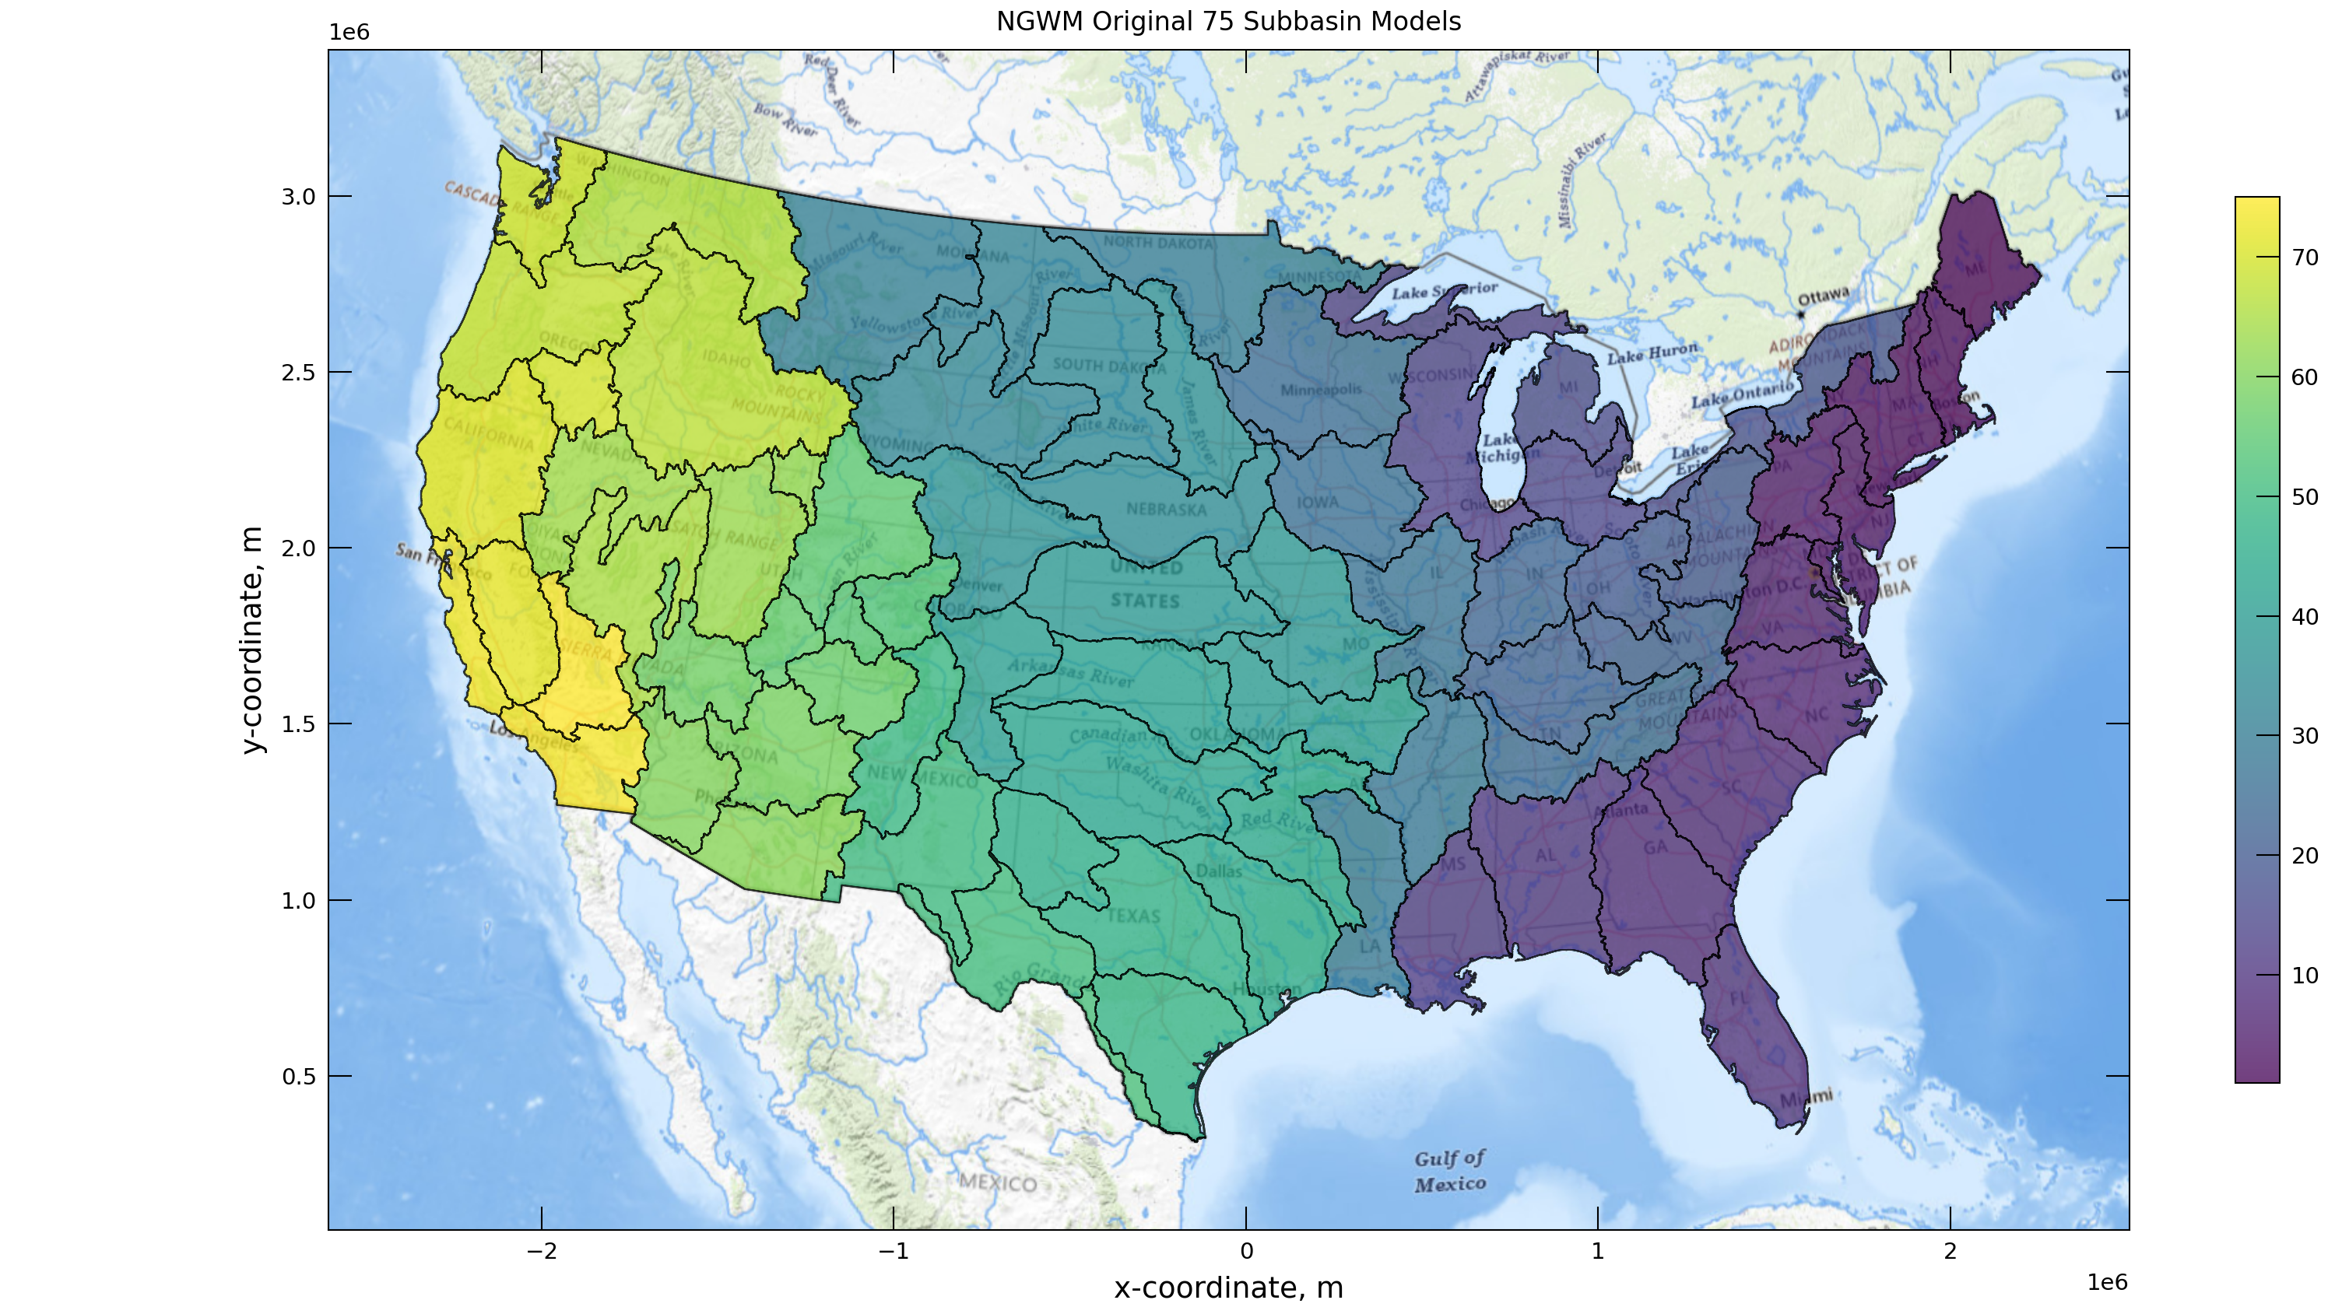
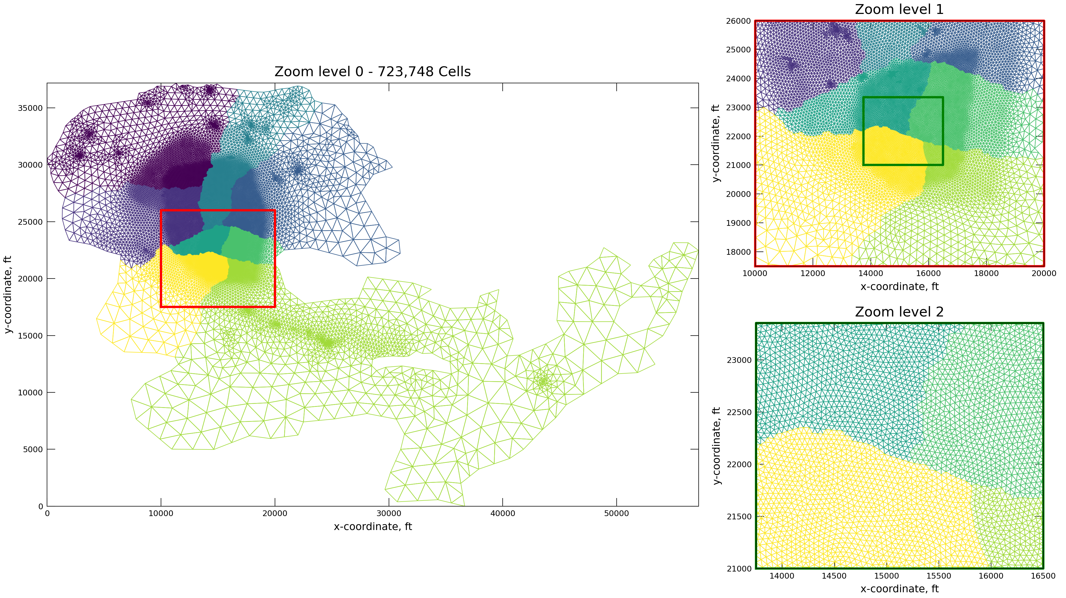
Motivation
Model of a Regional Groundwater Basin in Southern California,
Tetra Tech 2023
Large national/continental scale models
High resolution, regional models

Slide 3
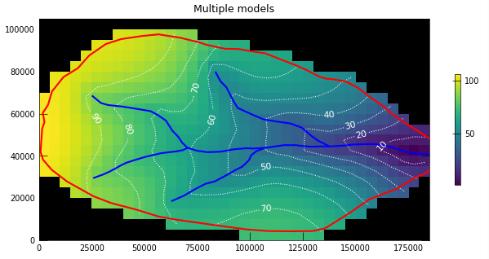

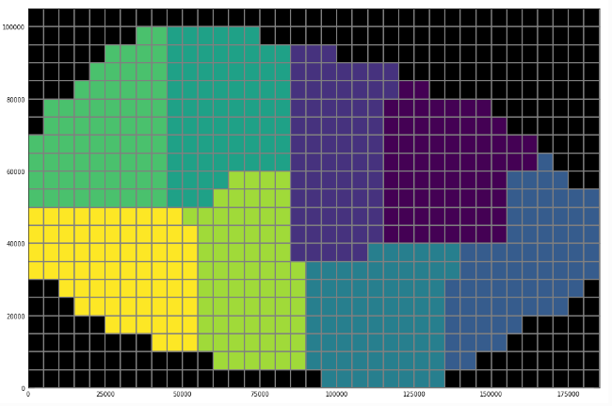
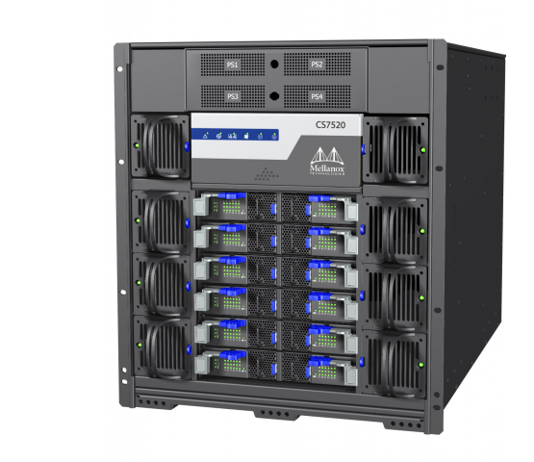
Strategy: Domain Decomposition
Instead of running a model on 1 processor core …
… distribute over many cores
Exchange of data at the domain interface
Efficiency affected by
Amount of communication between domains
Load imbalance: solution of multiple domains proceeds in lock step…

Slide 4
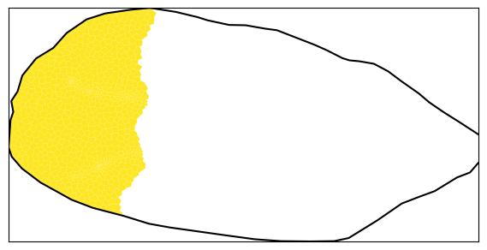
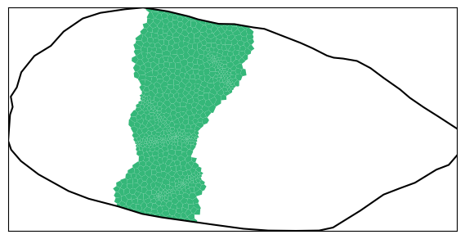
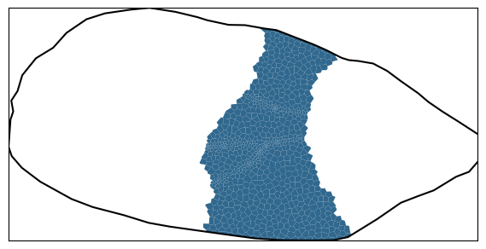
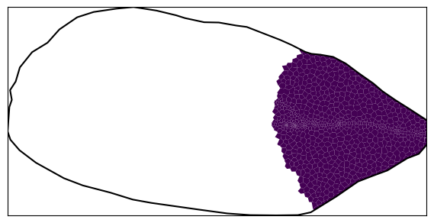
Parallel Solution
1
2
Example: solve the groundwater flow equation (Ax = b) over 4 domains
Dependent variable x (head) and right-hand side b are distributed
Each process now manages a contiguous set of rows of the system matrix
To solve this system:
choose A = M – N
M ≈ A and M_{ij}
M_{ij} = 0 for i ≠ j (Block-Jacobi), we use the iterative scheme:
x_{i}^{k+1} = M_{ii}⁻¹ (Σ_{j} N_{ij}x_{j}^{k} + b_{i})
Does not depend on x_{j}^{k+1}, hence parallel
3
4
A₁₁
x₁
b₁
A₂₂
x₂
b₂
=
A₃₃
x₃
b₃
A₄₄
x₄
b₄
Notes:
Solve the decomposed domain by

Slide 5
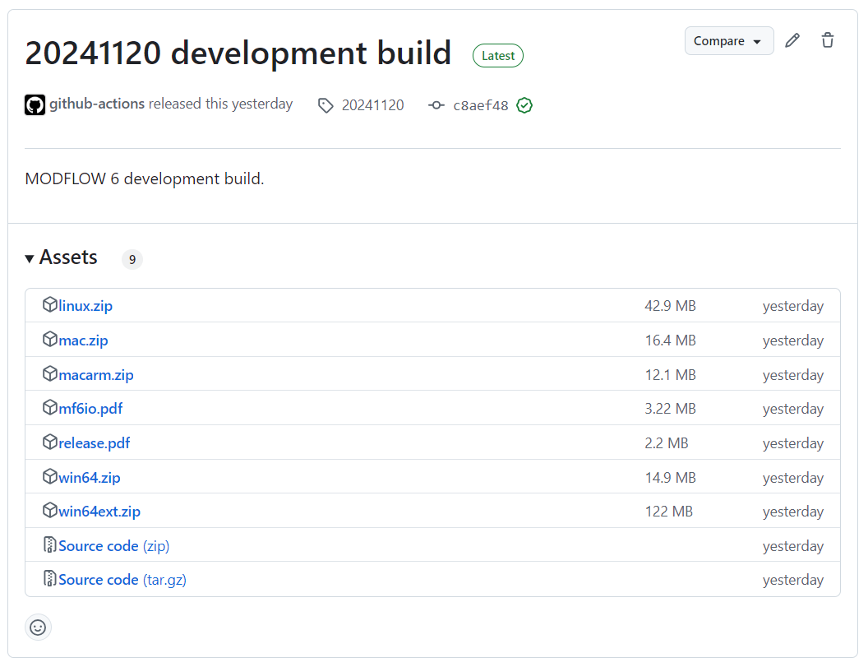
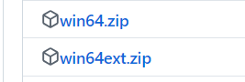
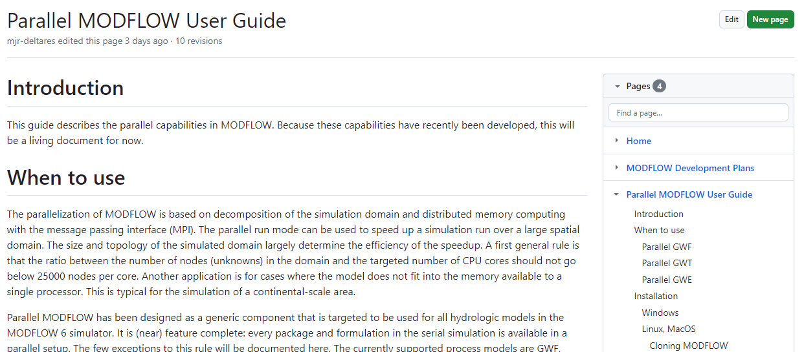
How to get it?
Windows:
Download ‘win64ext.zip’
Install through FloPy:
Linux/Mac
Instructions in the parallel user guide:
https://github.com/MODFLOW-USGS/modflow6/wiki/Parallel-MODFLOW-User-Guide
get-modflow --repo modflow6 --ostag win64ext :python
under development
Notes:
MODFLOW parallel is not standalone, third party libraries are needed. Mostly MPI and PETSc.

Slide 6
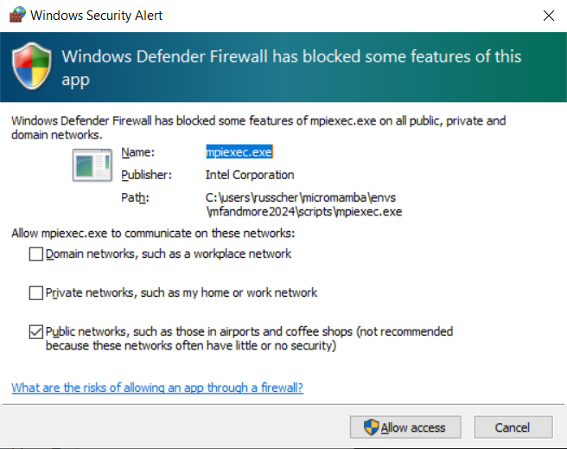
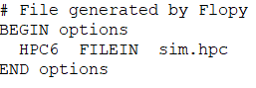
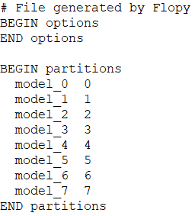
How to run it?
Partitioning with FloPy:
Assign models to cores: HPC file
Better load balance
optional
Run parallel simulation:
# create splitter using base simulation
mfsplit = flopy.mf6.utils.Mf6Splitter(base_sim)
# generate a splitting mask for the nr. of domains
split_array = mfsplit.optimize_splitting_mask(nparts=nr_domains)
# split the base model
parallel_sim = mfsplit.split_model(split_array)
mfsim.nam:
sim.hpc:
D:\> mpiexec.exe -np 8 mf6.exe -p

Slide 7
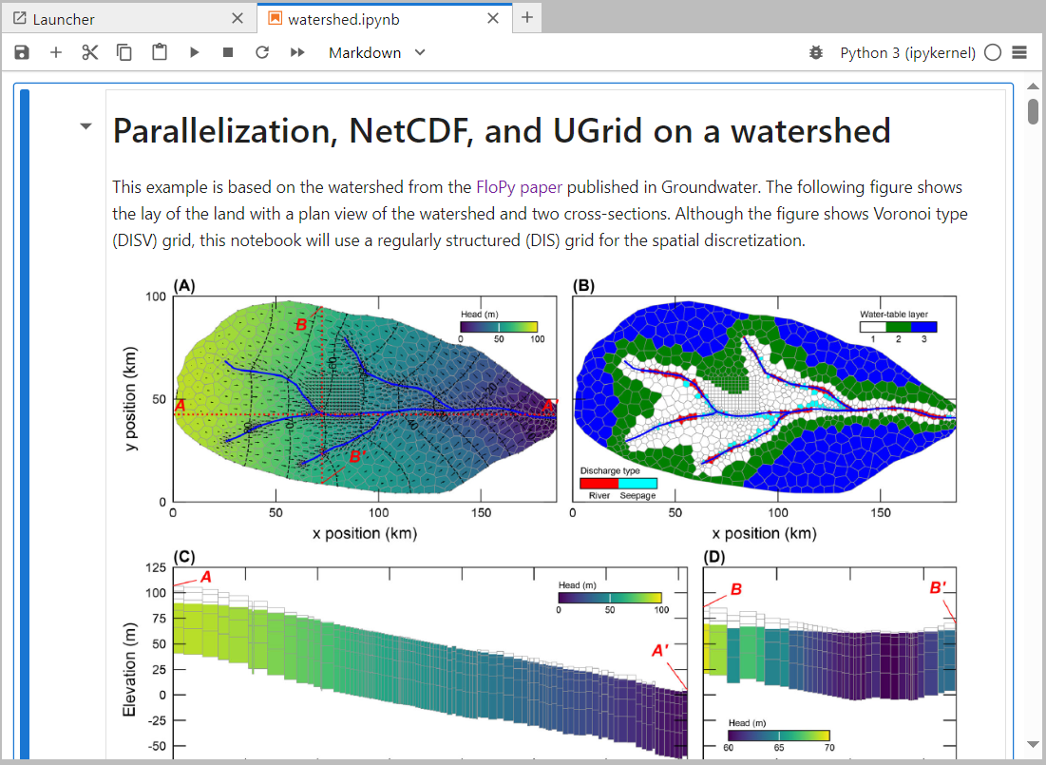
Notebook
Simulation
Temporal Discretization
Numerical Solution 1
Groundwater Flow Model 1
Numerical Solution 2
Groundwater Transport Model 1
Groundwater Transport Model 2
GWF-GWT
Exchange 1
GWF-GWT
Exchange 2

